Slide 1
Conditionals, Loops, and Arrays,
and More JS Libraries
Week 11

Slide 2
Conditional Statements

Slide 3
A conditional statement allows you to do different things based on the truthiness of a condition.
“If x is the case, then do y!”

Slide 4
Quick review of booleans (true and false)
Everything in JavaScript can be considered (“coerced”) to be true or false.
Things that are considered “true-like” are called truthy, and the others are called falsy.
Falsy: false, 0, '', null
Truthy: most other things that aren’t empty
Comparisons or checks also evaluate to true or false.

Slide 5
The if statement
let number = 5;
// print whether number is equal to 5
???

Slide 6
The if statement
let number = 5;
if (number == 5) {
console.log(“Number is equal to 5!”);
}
Number is equal to 5!

Slide 7
The if statement
let number = 5;
if (number == 5) {
console.log(“Number is equal to 5!”);
}
if (number > 4) {
console.log(“Number is greater than 4!”);
}
Number is equal to 5!
Number is greater than 4!

Slide 8
The if … else statement
let number = 5;
if (number > 3) {
console.log(“More than 3”);
} else {
console.log(“Less than or equal to 3”);
}
More than 3

Slide 9
The if … else statement
let number = 3;
if (number > 3) {
console.log(“More than 3”);
} else {
console.log(“Less than or equal to 3”);
}
Less than or equal to 3

Slide 10
The if … else if … else statement
let number = 3;
if (number == 3) {
console.log(“Number is 3”);
} else if (number > 3) {
console.log(“Greater than 3”);
} else {
console.log(“Less than 3”);
}

Slide 11
if statements inside other if statements!
let a = 5, b = 3;
if (a < 10) {
if (b < 10) {
console.log(“Both a and b are less than 10”);
}
}

Slide 13
Demo
https://tinyurl.com/wdd-if-loop

Slide 14
Loopy Loops!

Slide 15
A for loop allows you to repeat some code until
a certain condition is met,
or for a certain number of times.

Slide 16
What is a for loop?
Does a thing for you a certain number times without you having to write out every single iteration
Cleaner, more maintainable code
for (let i = 0; i < 10; i++) {
console.log(“counting to 9: ”, + i);
}

Slide 17
Why use a for loop?
for (let i = 1; i < 10; i++) {
console.log(“counting to 9: ”, + i);
}
console.log(“counting to 9: ”, + 1);
console.log(“counting to 9: ”, + 2);
console.log(“counting to 9: ”, + 3);
console.log(“counting to 9: ”, + 4);
console.log(“counting to 9: ”, + 5);
console.log(“counting to 9: ”, + 6);
console.log(“counting to 9: ”, + 7);
console.log(“counting to 9: ”, + 8);
console.log(“counting to 9: ”, + 9);

Slide 18
for loop breakdown: start
Create a variable named i
Stands for “index”
Set the variable value to 0
for (let i = 0; i < 10; i++) {
console.log(“counting to 9: ”, + i);
}

Slide 19
for loop breakdown: end
Keep doing the action(s) inside the for loop while i is less than 10
for (let i = 0; i < 10; i++) {
console.log(“counting to 9: ”, + i);
}

Slide 20
for loop breakdown: repeat
Increment i by 1 every time the loop repeats execution
Also written as i += 1
for (let i = 0; i < 10; i++) {
console.log(“counting to 9: ”, + i);
}

Slide 21
What will this print?
for (let i = 0; i < 10; i++) {
console.log(i);
}

Slide 22
What will this print?
for (let i = 1; i < 12; i++) {
console.log(i);
}

Slide 23
What will this print?
for (let i = 0; i <= 10; i++) {
console.log(i);
}

Slide 24
What will this print?
for (let i = 1; i < 4; i++) {
for (let j = 1; j < 4; j++) {
console.log(i, j);
}
}

Slide 25
What will this print?
for (let i = 1; i < 4; i++) {
for (let j = 1; j < 4; j++) {
console.log(i, j);
}
console.log(“potate”);
}

Slide 26
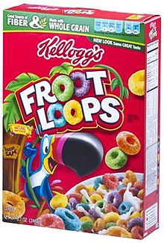
Other Kinds of Loops
While loops
Do-while loops
For-each loops
Froot Loops!

Slide 28
Demo
https://tinyurl.com/wdd-for-loop

Slide 29
Arrays

Slide 30
In JavaScript, an array is a list of values (perhaps of different types)

Slide 31
Array examples
[102, 82, 34]
["WDD", "is", "awesome!"]
["It is", 2018]
["Is it", true, 432]

Slide 32
Array indexing
A lot of programming languages have zero-indexed arrays, so to get the first item from an array, we use [0]
const numbers = [20, "potato", 30];
console.log(numbers[0]); // Output: 20
console.log(numbers[1]); // Output: potato
console.log(numbers[2]); // Output: 30
// Similar to how strings output characters
const text = "WDD";
console.log(text[0]); // Output: W
console.log(text[1]); // Output: D

Slide 33
Array properties & methods
array.length Returns the length of the array
array.push(item1, item2, item3, …) Adds a new item to the end of the array
array.pop() Removes the last item in the list and returns it
Notice that the array mutates "internally"
const numbers = [];
console.log(numbers.length); // Output: 0
numbers.push(1, 2, 3);
console.log(numbers); // Output: [1, 2, 3]
console.log(numbers.length); // Output: 3
numbers.pop();
console.log(numbers); // Output: [1, 2]
console.log(numbers.length); // Output: 2
numbers.push(4, 5, 6);
console.log(numbers); // Output: [1, 2, 4, 5, 6]
console.log(numbers.length); // Output: 5

Slide 34
Iterating over an array
Approaching from a traditional for-loop
Since there are as many as farms.length strings in the array, we iterate i over the range of indices and use farms[i] to get the name of each farm in the array.
const farms = [
"Homegrown Organic Farms",
"Tomatero Organic Farm",
"Tutti Frutti Farms"
];
for (let i = 0; i < farms.length; i++) {
console.log("Does", farms[i], "have potatoes?");
}

Slide 36
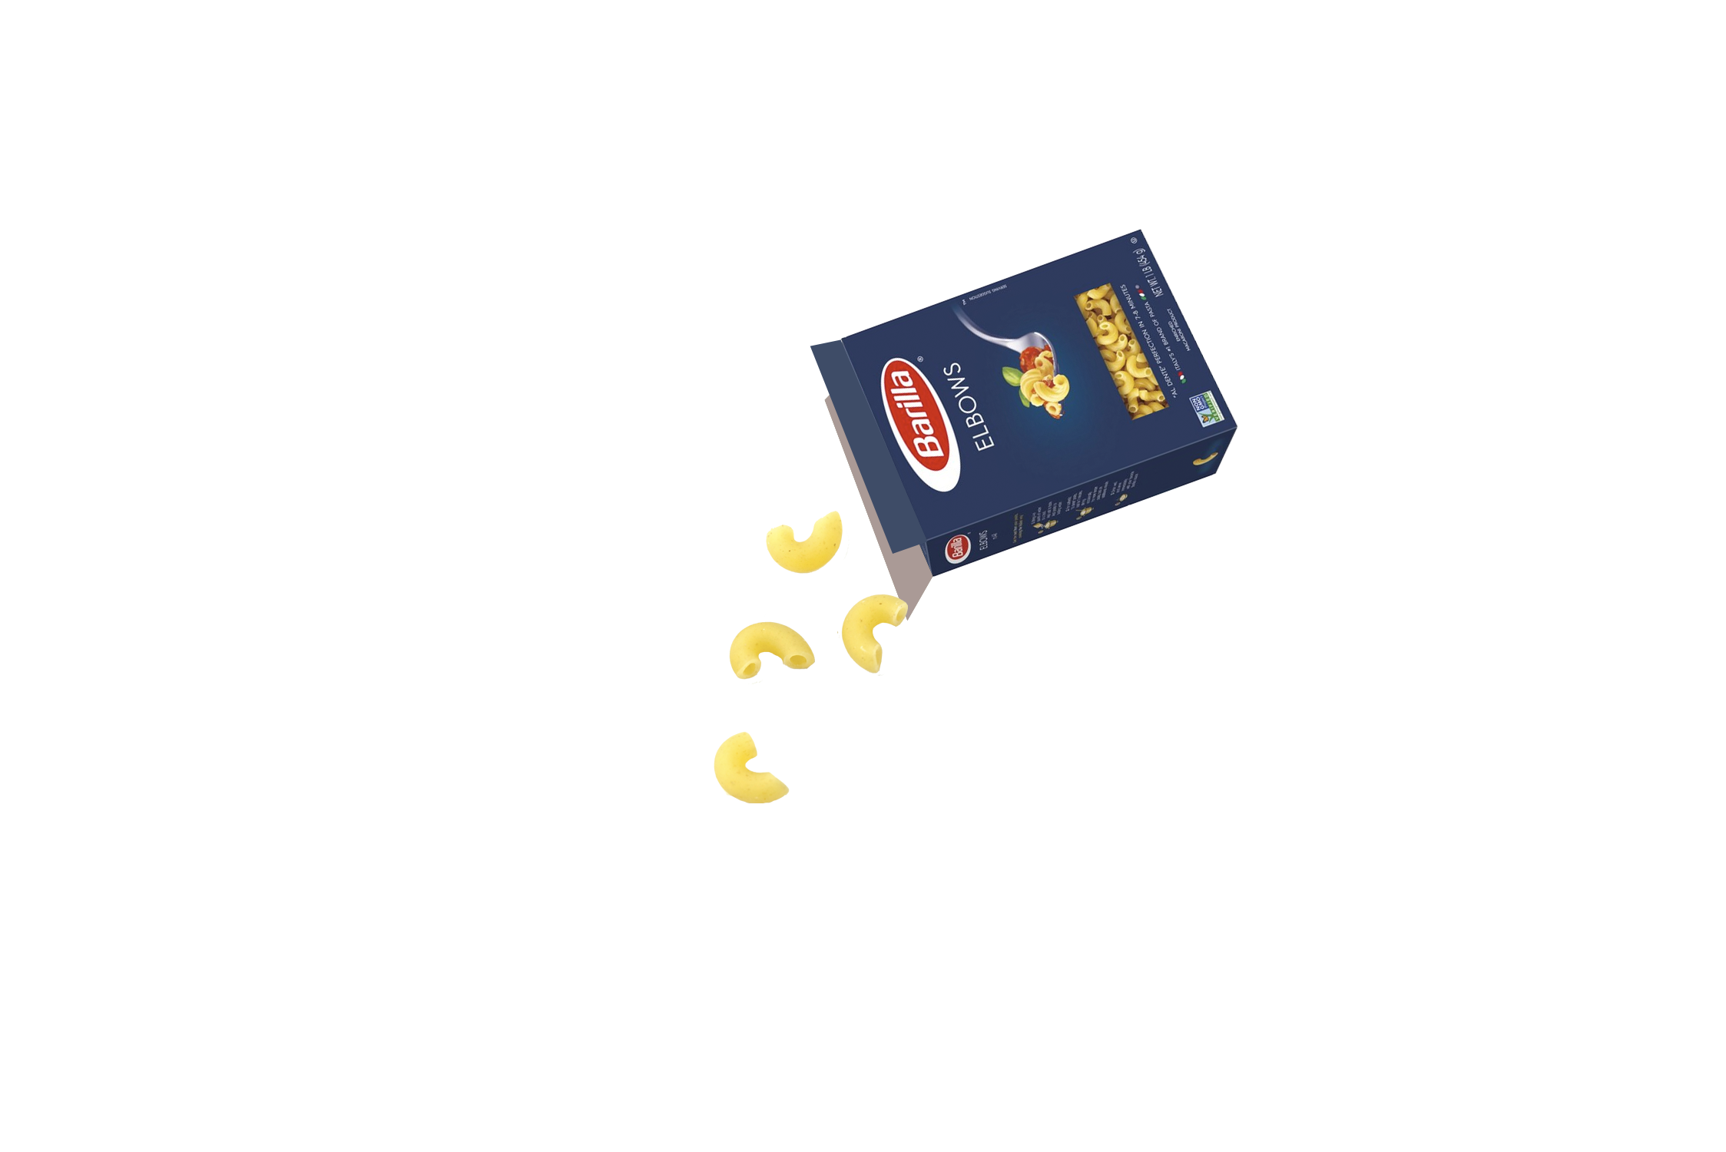

Bring On the Pasta

Slide 37
Languages and Frameworks and Libraries, Oh My!
Where JavaScript is a language, jQuery is a library:
JavaScript, like HTML or CSS, has a set of syntax rules that define a logical, executable environment.
Frameworks, libraries, and plugins are built on top of a language, and act as tools that we can use right out of the box.
Handy article: is jQuery a framework or a library

Slide 38
Languages and Frameworks and Libraries, Oh My!
What about frameworks, libraries and plugins?
Frameworks tell us how to structure our code to make things easier for ourselves in the long run.
Libraries are building blocks that offer us generally helpful functionality for broad applications.
Plugins are extensions of an application, framework, or library.
Handy articles: frameworks vs. libraries (in JS), libraries vs. plugins (in Java)

Slide 40
Where do I find plugins?
tldr: Online!
Some nice starting points:
https://www.javascripting.com/
https://plugins.jquery.com/
https://www.creativebloq.com/jquery/top-jquery-plugins-6133175
https://tutorialzine.com/2013/04/50-amazing-jquery-plugins
http://www.unheap.com/***
https://getflywheel.com/layout/best-javascript-libraries-frameworks-2019/

Slide 41
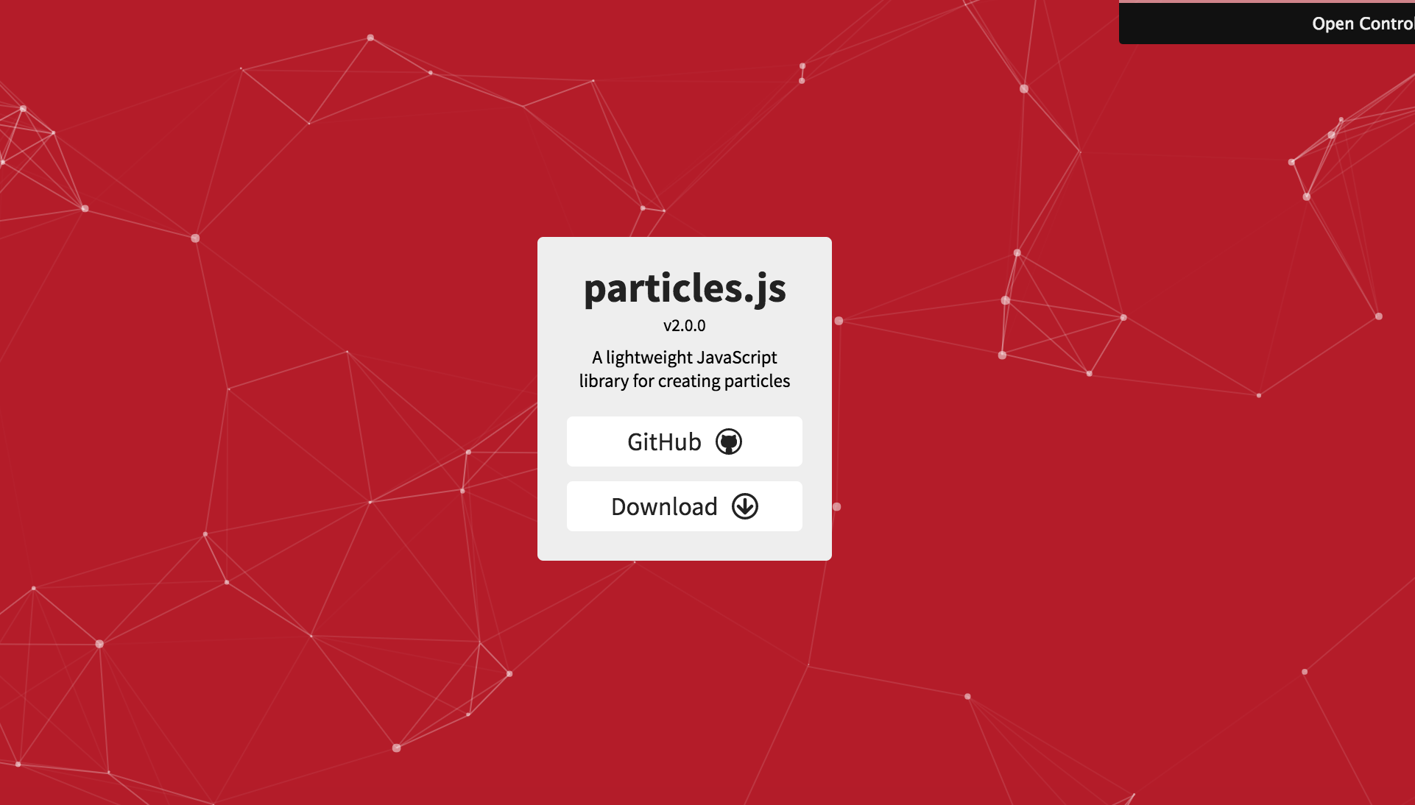
particles.js

Slide 42
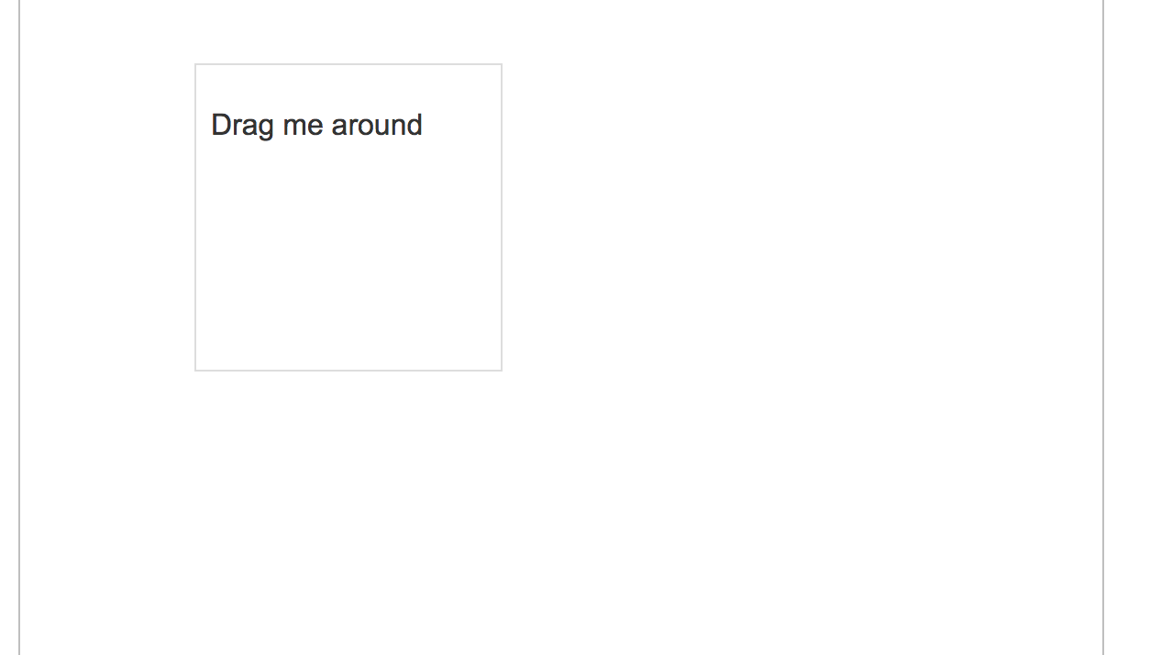
jQuery UI

Slide 43
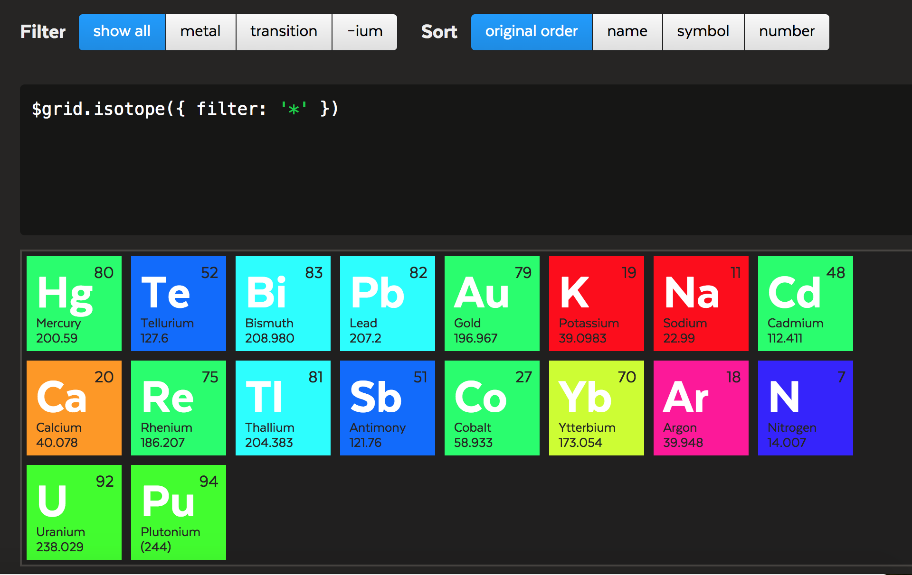
Isotope

Slide 44
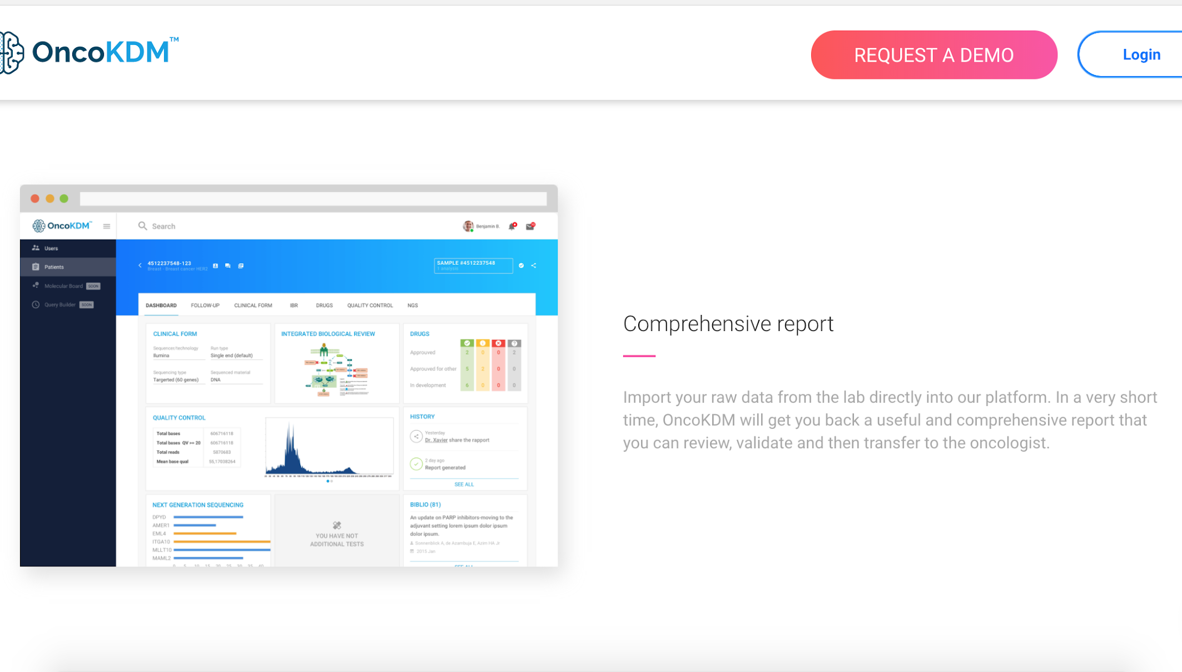
Waypoints
example

Slide 45
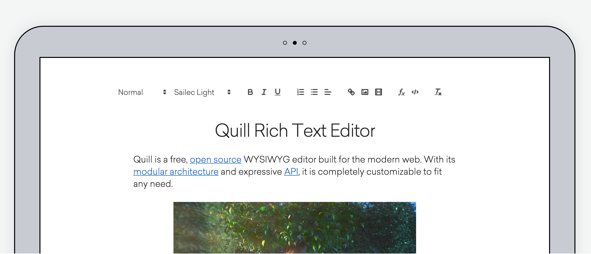
Quill

Slide 46
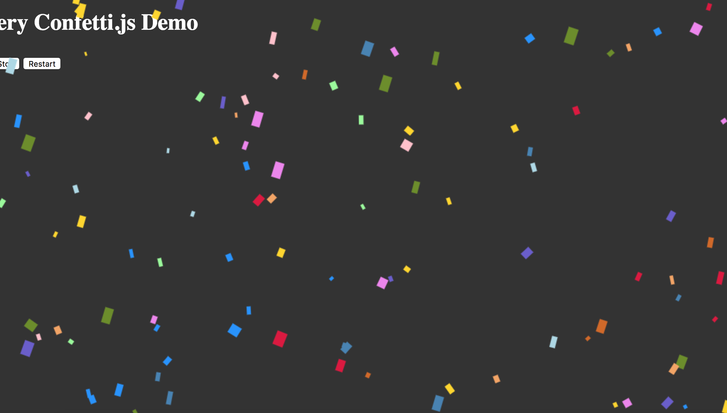
Confetti for when you need to recreate your berkeley letter of acceptance to feel a sense of gratification again

Slide 47
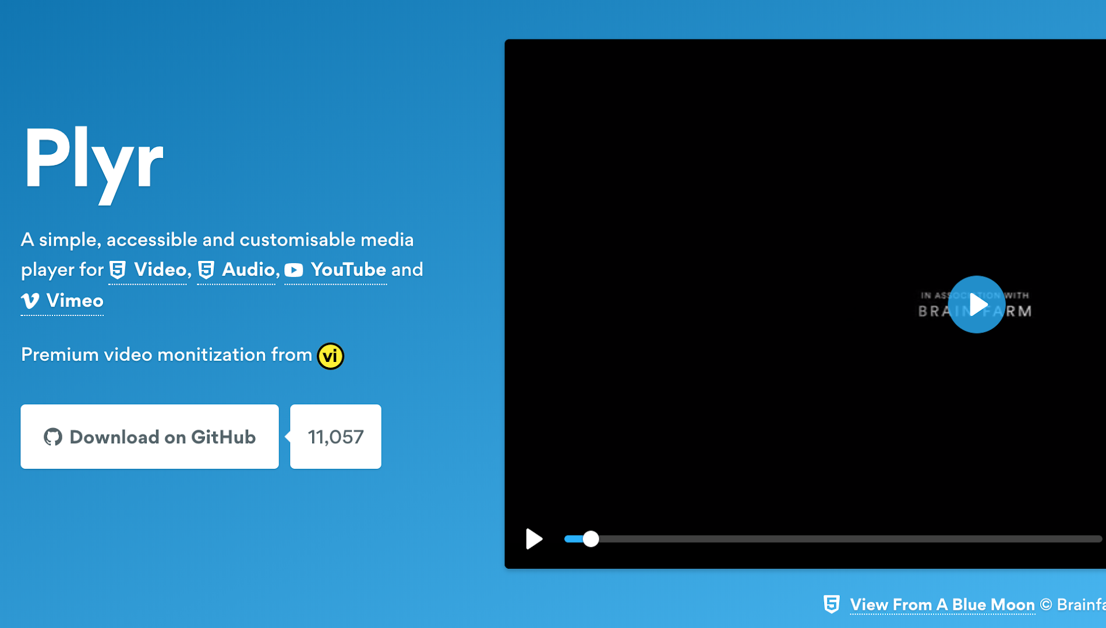
Plyr

Slide 48
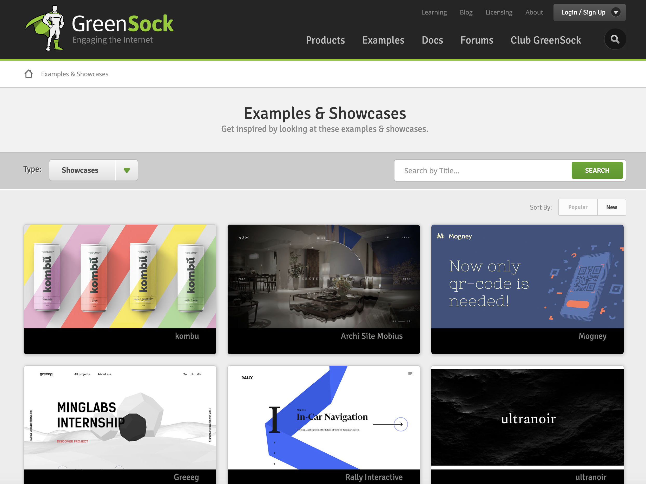
Greensock

Slide 49

SnapSVG

Slide 50
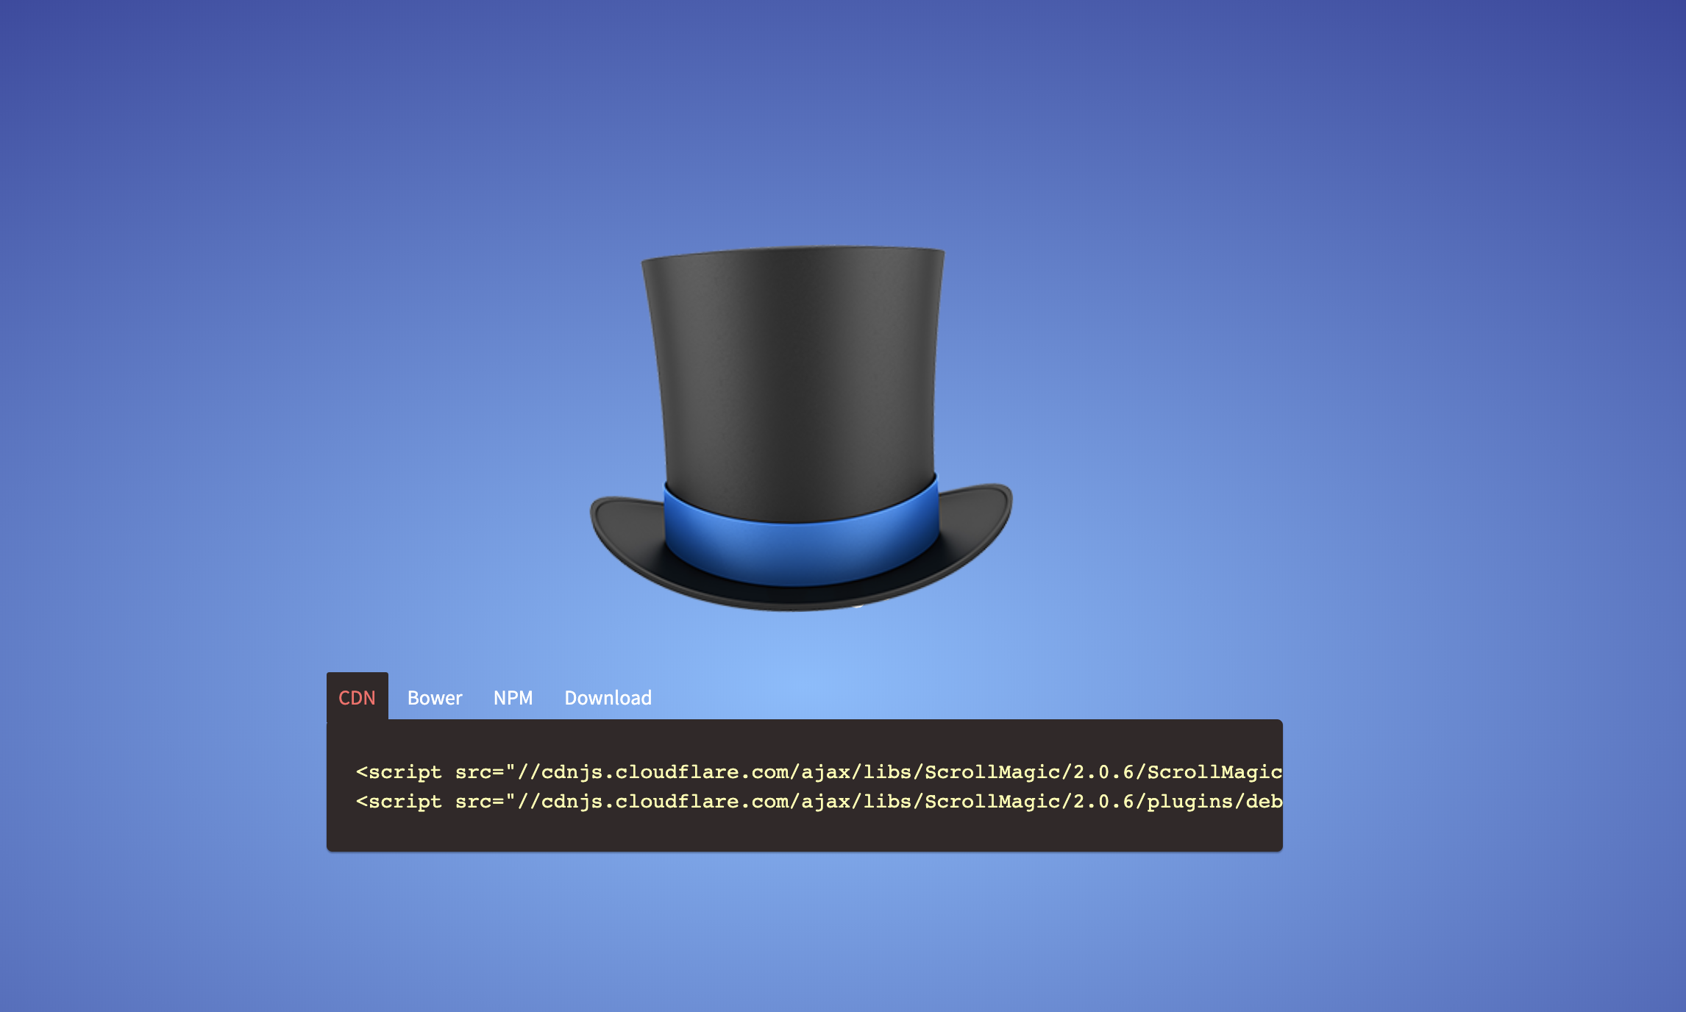
Scrollmagic

Slide 51

three.js
(example: Codrops’ “The Aviator”)

Slide 52
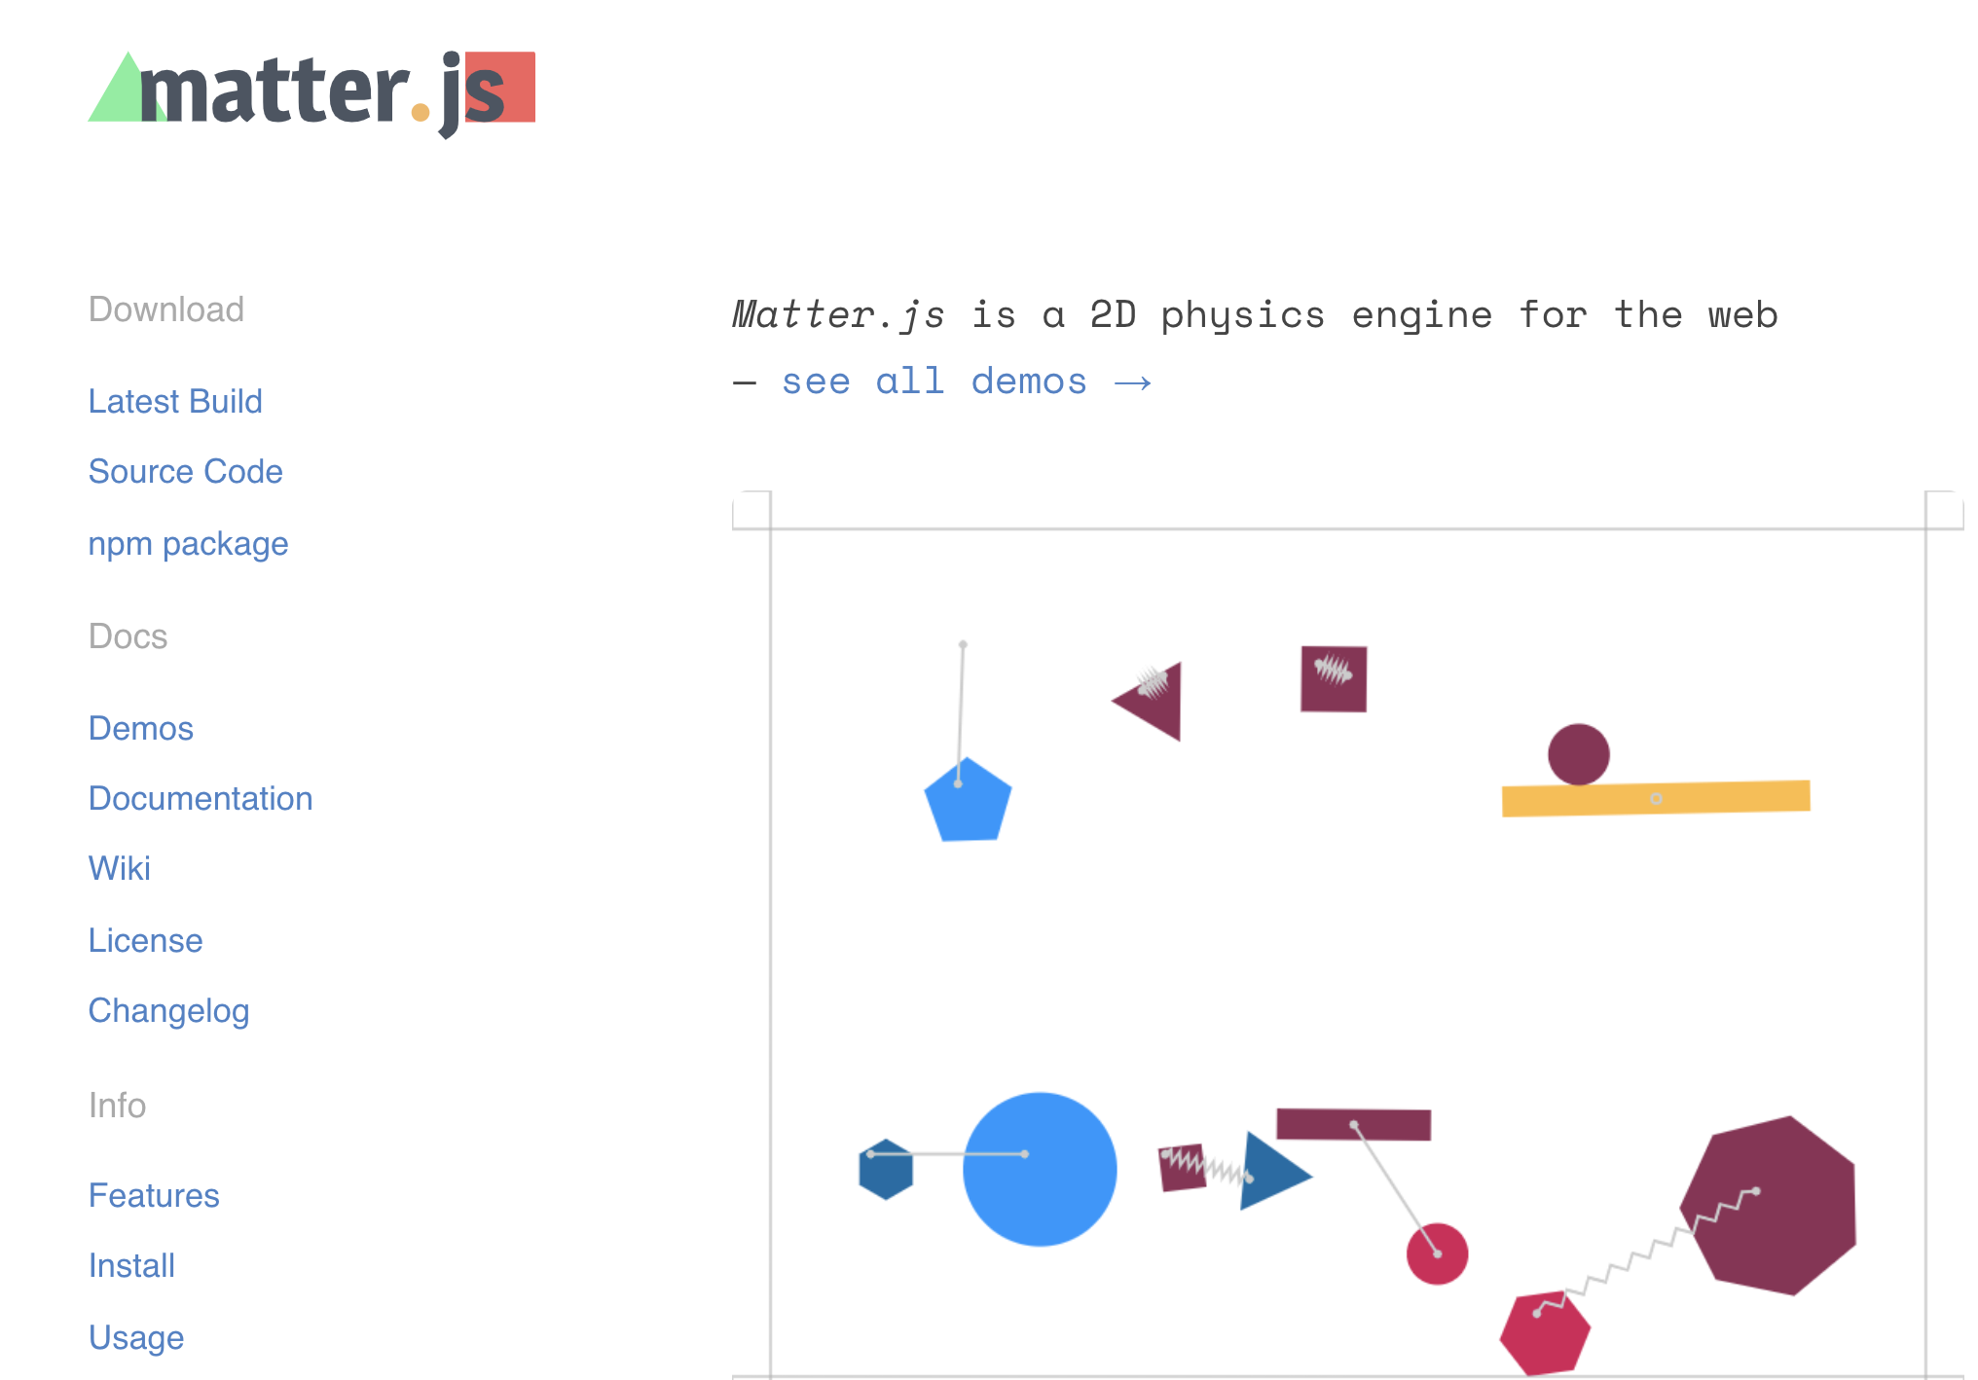
matter.js

Slide 53
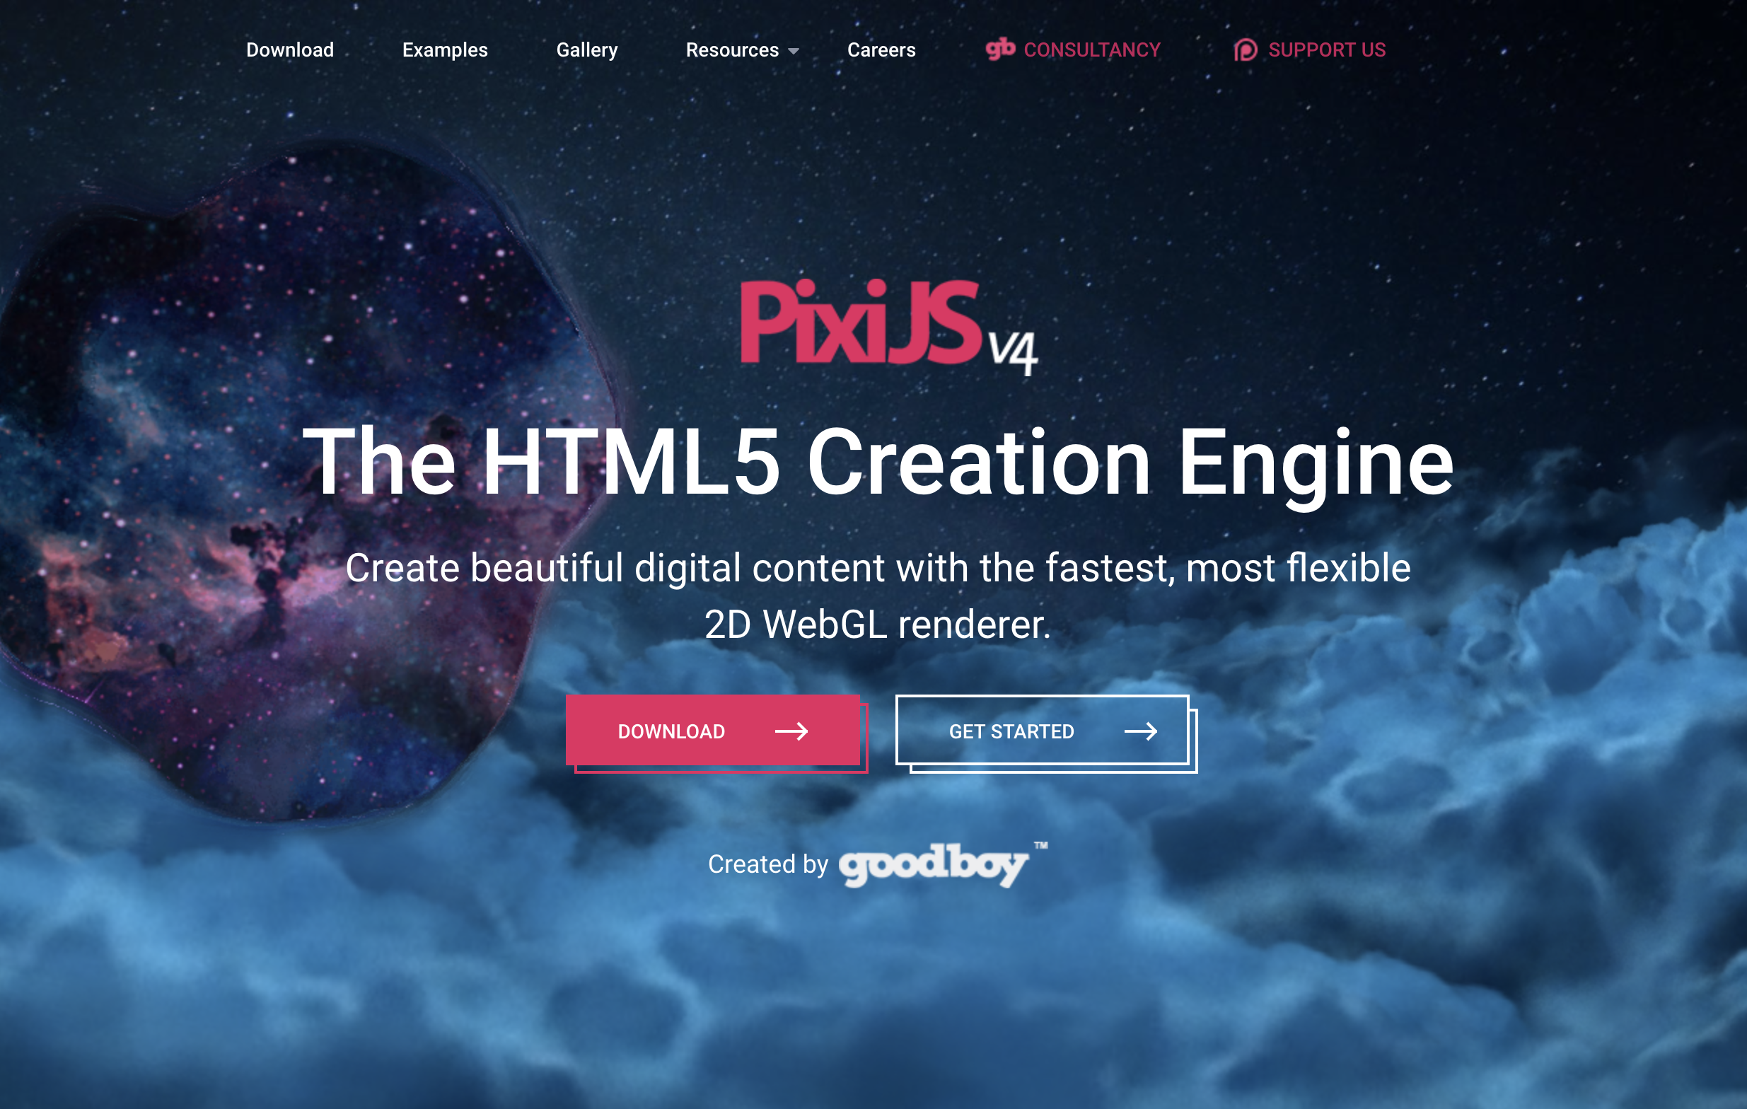
PixiJS

Slide 54
To plugin or not to plugin?
A very heated debate! A few online opinions for your perusal:
All JavaScript frameworks are terrible
By the same author: JavaScript Frameworks Are Great
Why You Shouldn't Use A Web Framework
When not to use a JavaScript framework
When to avoid using Javascript Libraries (Jquery)
The deepest reason why modern JavaScript frameworks exist
Why you shouldn’t spend one more second choosing a JS framework

Slide 55
To plugin or not to plugin?
Some helpful takeaways and common arguments:
Choose tools that solve problems you have had and understand, not problems that you can foresee yourself having.
Minimize complexity--use only those tools which you truly need.
Reinvent the wheel sparingly. If a tool already does something well, use it! But if it does it in an unnecessarily complex way for your use case, then build your own (e.g. grid and animation systems).
If JS already natively has it, you might not need a plugin for it.

Slide 56
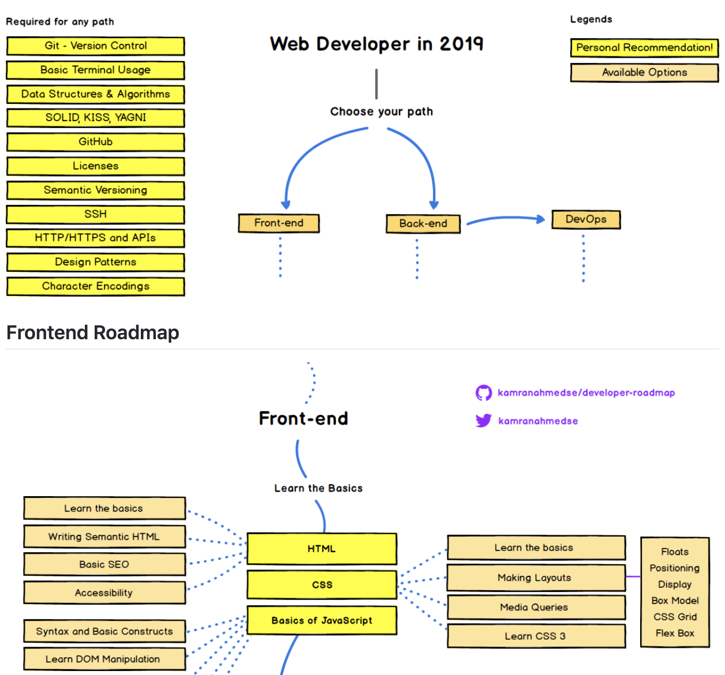
Onward and Upward: Your Web Dev Path
roadmap

